Slide 1
Understanding and Developing Hierarchical Linear Models
Alexander Yin
The Pennsylvania State University
(acy1@psu.edu)
AIR Workshop (May 30, 2009)

Slide 2
Outline
Regression and HLM
Data Requirements
Developing HLM
Unconditional Model
Model with only level-2 predictors
Model with only level-1 predictors (Random Coefficient Model)
Complete Model
Variance Structures
Centering

Slide 3
Note:
This workshop will focus on hierarchical linear models that deal with subjects nested in a cluster.
Example: Students nested in an institution
Example: Students nested in a school district***
HLM can also handle situations such as growth within a person (i.e., repeated measures), but I will not cover those types of models in this workshop. However, after this workshop you will have the fundamentals to develop those type of models.

Slide 4
Goal
Understand and develop hierarchical linear models
Mixed Command (in SPSS, SAS, and STATA)
Develop the fundamentals so you can do growth-type models within an individual
Develop the fundamentals so you can utilize knowledge about logistic regression and develop other types of multi-level models
Similarities and differences between multiple regression and HLM

Slide 5
Regression and HLM
Model Evaluation
R-square versus Variance Explained
Parameter Estimates
Intercept and Slope Coefficients
Interpretation of effects is relatively the same
Check for significant in the same fashion
Variance Components (for HLM models)
Examine whether intercept or slope should be treated as random or fixed

Slide 6
Why HLM:
Violation of independence is violated when dealing with subjects within a nested structure if you use multiple linear regression.
Statistic consequence
standard errors for coefficients are underestimated
In English:
Coefficients may be statistically significant when they really shouldn’t be (Remember this for the end of the workshop though).

Slide 7
So HLM allows for:
Improved estimation of effects within individual units
Formulation and testing of hypothesis about cross level effects
Partition of variance and covariance components among levels
(Raudenbush & Bryk, 2002, p.7)

Slide 8
Data requirements and Format
Multi-level modelers suggest
Minimum of thirty groups/ clusters
Individuals within groups average at least ten
Some groups may have only one individual
(Porter, 2005)
Data Format
Mixed Commands (1 worksheet)
HLM software (2 worksheets)
1 worksheet for variables at level 1
1 worksheet for variables at level 2

Slide 9
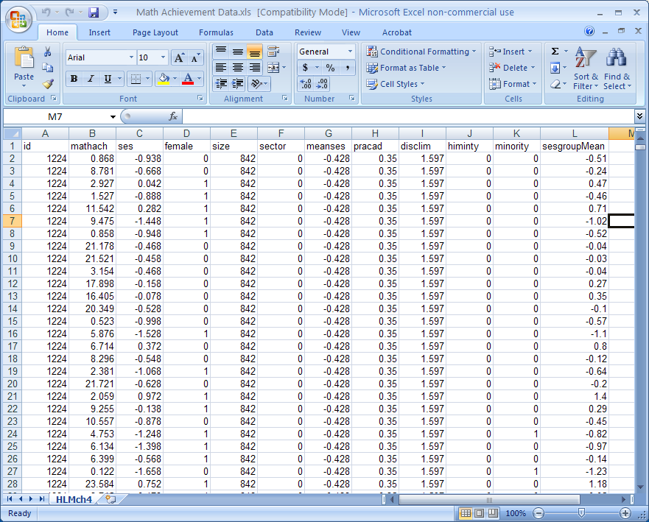
Data format example

Slide 10
Developing HLM Models
Let’s get started and remember:
Got to keep trying Got to keep my head held high There's always going to be another mountain I'm always gonna wanna make it move Always going to be an uphill battle, Sometimes I'm gonna have to lose, Ain't about how fast I get there, Ain't about what's waiting on the other side It's the climb
Miley Cyrus (“The Climb”)

Slide 11
Notations

Slide 12
Unconditional Model (aka ANOVA)
Why do this step?
Partition of variance between the levels
Check to see if HLM is necessary
Level-1 Model:
Y_{ij} = β_{0j} + r_{ij}
Level-2 Model:
β_{0j} = γ₀₀ + μ_{0j}
Full Model:
Y_{ij} = γ₀₀ + μ_{0j} + r_{ij}
For the Mixed Commands– you always want to write out the full model. It will be easier to identify the random and fixed components

Slide 13
Unconditional Model
Full Model:
Y_{ij} = γ₀₀ + μ_{0j} + r_{ij}
Important to identify the fixed and random components

Slide 14
Unconditional Model Code

Slide 15
Run the code with Math achievement (Mathach) as the dependent variable and school district (ID) as the cluster unit.

Slide 16
Interested output
Estimates of covariance parameters
SAS – “Covariance Parameter Estimates”
SPSS- “Estimates of Covariance Parameters”
STATA- Random-effects parameters
Parameter Estimates
SAS – “Solution for Fixed Effects”
SPSS- “Estimates of Fixed Effects”
STATA- Name of dependent variable (Mathach)
Information Criteria
SAS- “Fit Statistics”
SPSS- “Information Criteria”
STATA – run the command line estat ic

Slide 17
Estimates of covariance parameters
Calculate the intraclass correlation (ρ)
Interpretation: The proportion of variance in the dependent variable that is attributed to level-2
If > than .05, than HLM is appropriate method
Remember the values of τ₀₀ and σ²

Slide 18
Model with only Level-2 Predictors
Why do this step?
Explain some of the variance at level-2 (i.e., reduce τ₀₀ )
Level-1 Model:
Y_{ij} = β_{0j} + r_{ij}
Level-2 Model:
β_{0j} = γ₀₀ + γ_{0cat1} * w_{cat1} + … + γ_{0n} * w_{catn} +
γ_{0cont1} * w_{cont1} + … + γ_{0contm} * w_{contm} + μ_{0j}
Full Model:
Y_{ij} = γ₀₀ + γ_{0cat1} * w_{cat1} + … + γ_{0n} * w_{catn} +
γ_{0cont1} * w_{cont1} + … + γ_{0contm} * w_{contm} + μ_{0j} + r_{ij}
Can you identify the random and fixed components?

Slide 19
Level-2 Model Code

Slide 20
Run the code with Math achievement (Mathach) as the dependent variable, school district (ID) as the cluster unit, and Mean SES in school district (meanses) as a level-2 predictor variable.
Let’s start by writing out the Level-1 Model and Level-2 Model and then the Full Model. Now run the code

Slide 21
Estimates of covariance parameters
First find τ₀₀ for this model. Is it significant?
If yes– other level-2 predictors can be added
If no – no other level-2 predictors should be added
Calculate the “variance explained” or “proportion reduction in variance”
Interpretation: The proportion of variance explained by the level-2 predictors is (###) percent.
This is why I asked you to record the τ₀₀ of the unconditional model

Slide 22
Model with only Level-1 Predictors
Also known as the Random Coefficient Model.
Why do this step?
Explain some of the variance at level-1 (i.e., reduce σ² )
Determine which coefficients should be model as random or as fixed
Random - coefficient varies across the clusters
Fixed - coefficient is constant across the clusters
Statistical fact: a random * a constant = random
This is a helpful fact in determining the random and fixed components of the full model.

Slide 23
Model with only Level-1 Predictors
Level-1 Model:
Y_{ij} = β_{0j} + β_{cat1j} * x_{cat1} + … + β_{catnj} * x_{catn}
+ β_{cont1j} * x_{cont1} + … + β_{contmj} * x_{contm} + r_{ij}
Level-2 Model:
β_{0j} = γ₀₀ + μ_{0j}
β_{cat1j} = γ_{cat10} + μ_{cat1j}
…
β_{catnj} = γ_{catn0} + μ _{catnj}
β_{cont1j} = γ_{cont10} + μ_{cont1j}
…
β_{contmj} = γ_{cont10} + μ_{contmj}

Slide 24
Model with only Level-1 Predictors
Full Model:
Y_{ij} = γ₀₀ + μ_{0j} + (γ _{cat10} + μ_{cat1j})* x_{cat1} + … + (γ_{catn0} + μ_{catnj})* x_{catn} + (γ_{cont10} + μ_{cont1j} )* x_{cont1} + … + (γ_{contm0} + μ_{contmj})* x_{contm} + r_{ij}
Y_{ij} = γ₀₀ + γ _{cat10} * x_{cat1} + … + γ_{catn0} * x_{catn}
+ γ_{cont10} * x_{cont1} + …+ γ_{contm0} * x_{contm}
+ μ_{cat1j} * x_{cat1} + …+ μ_{catnj} * x_{catn}
+ μ_{cont1j} * x_{cont1} + …+ μ_{contmj} * x_{contm} + r_{ij}
Can you identify the random and fixed components?

Slide 25
Run the code with Math achievement (Mathach) as the dependent variable, school district (ID) as the cluster unit, and Individual SES minus the Mean SES in school district (SESCenterGroup) as a level-1 predictor variable.
Let’s start by writing out the Level-1 Model and Level-2 Model and then the Full Model. Now run the code

Slide 26
Level-1 Model Code

Slide 27
Estimates of covariance parameters
First find σ² for this model. Is it significant?
If yes– other level-1 predictors can be added
If no – no other level-1 predictors should be added
Calculate the “variance explained” or “proportion reduction in variance”
Interpretation: The proportion of variance explained by the level-1 predictors is (###) percent.
This is why I asked you to record the σ² of the unconditional model

Slide 28
Estimates of covariance parameters
Notice now you have tons of other variance components in this section. Unlike multiple regression, HLM is also estimating variance and covariance components of the random components in your model. (Basically this is a n x n matrix, where n is the number of random components in your model)
Notation for all programs is UN(i,j), when i=j, these are the estimated variance components (τ_{qq} ) of the random coefficients. Check to see which ones are significant.
If significant – model variable as random
If not significant – model variable only as fixed
When i ≠ j these are the estimated covariance of the random coefficients.

Slide 29
Complete model
Why do this step?
This is putting all the pieces together
(Check the guide to find the level-1, level-2, and full model equations)

Slide 30
Run the code with Math achievement (Mathach) as the dependent variable, school district (ID) as the cluster unit, and Individual SES minus the Mean SES in school district (SESCenterGroup) as a level-1 predictor variable.
Let’s also add the following level-2 variables Mean SES in school district (Meanses) and sector (which you found significant when you did the level-2 models).
Let’s start by writing out the Level-1 Model and Level-2 Model and then the Full Model. Now run the code

Slide 31
What did you find?

Slide 32
Variance Structures
HLM is estimating variance/covariance components

Slide 33
Variance Structures
Why care?
Save computational processing time
Can’t get the variance matrix to converge (because of co linearity between the random coefficients)
Theoretically, it makes sense

Slide 34
Variance Structures
Why care?
Save computational processing time
Can’t get the variance matrix to converge (because of co linearity between the random coefficients)
Theoretically, it makes sense

Slide 35
Centering
Three options:
The natural X metric (aslo refer to as the raw score)
Centering around the grand mean
Centering around the group mean
Natural X-metirc and Centering around the grand mean produce equivalent statistic model
The suggestion though is to center (either grand mean or group mean) the variable to provide a more meaningful interpretation of the fixed intercept term and to ease estimation computations and stability (Kreft, de Leeuw, & Aiken, 1995).

Slide 36
Contextual Models
Adding the group or grand mean as a Level-2 variable as we did with SES.
Group-mean centering
Decomposes the effects into within and between clusters
Grand-mean centering
Provides the compositional (sum of the within - and between cluster unit effects) and the within –cluster effect
(see Table 5.11 on p. 140 in Raudenbush and Bryk (2002)
English speak: Nature versus Nurture

Slide 37
A final thought before wrap-up
Do you remember that stat fact I talked about early in the workshop about multiple regression and HLM?
Well, this is a useful fact to know, because the mixed procedure does not have an “enter” option (i.e., stepwise, forward, backward). This stinks, because do you really want to sit at your computer and figure out which variables to include in your model?

Slide 38
A final thought before wrap-up
Of course not. So your first step is to run a multiple regression using the “enter” option to reduce the list of predictors you want to investigate in your HLM. If they are insignificant for multiple regression then they will also be insignificant for HLM.

Slide 39
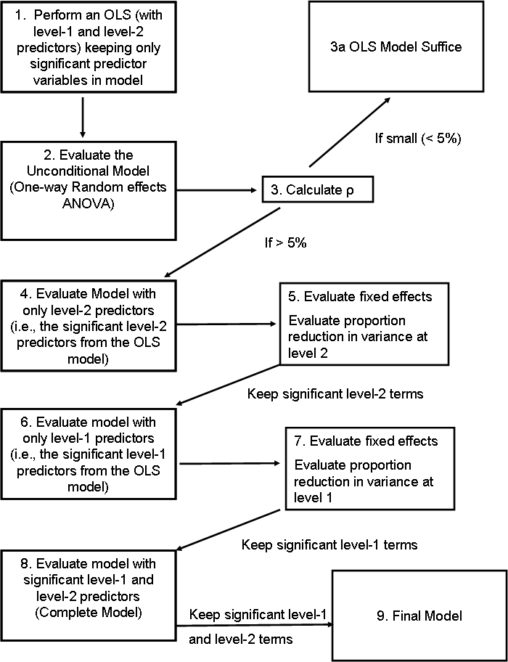
Wrap-Up

Slide 40
Future Skill Development
If you understand everything from this workshop:
Your next step is to develop growth models
Need to use the “repeated” option in the mixed procedure-
Everything else is pretty much the same
This workshop dealt with a continuous dependent variable– but what about a dichotomous dependent variable
The concepts are the same
I actually haven’t explored more in-depth in how do this in SPSS, SAS, and STATA
In HLM software, it’s pretty changing the link to “logit.”
These are the basics to building and developing an HLM, however, you still may encounter issues that can only be answered by a statistician.

