Slide 1
CUNY Application and New Student Data
Featured Topics:
Available data
Common uses
Data processing
Plans for the future
Interesting findings on new student enrollment
Sarah Truelsch, Data Group March 20, 2013

Slide 2
Sources of Applicant Data
Freshman
Processed by University Application Processing Center (UAPC)
We collect through CAS (Central Application System) extract
Transfer students
Processed by UAPC
We collect through ASTA extract (Advanced Standing Transfer Admission)
Graduate students
No central application processing, no central data collection (so far, changing under CUNYFirst)
Notes:
We make requests for this data near the start of each term

Slide 3
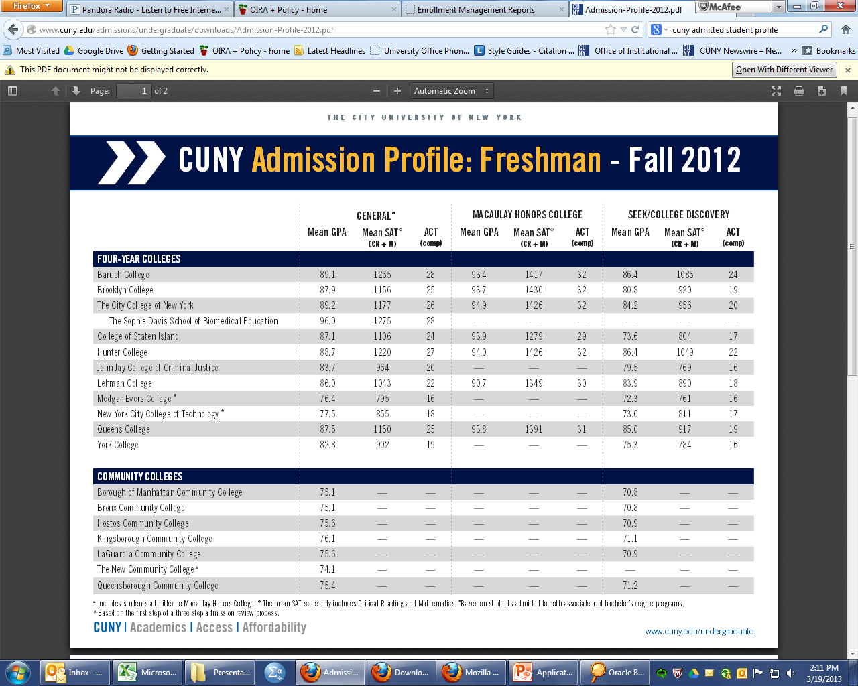
Example Reports: Admitted and Enrolled Student Profiles
CAS is the source of all pre-college academic data: HS, SAT scores, HS HPA
Notes:
Any place that you see high school type defined, it comes from the CAS application data
Source of all pre-college data: SAT scores, HS GPA,

Slide 4
Example Reports: Drill Down Tables
http://owl.cuny.edu:7778/portal/page/portal/oira/Enrollment%20Management%20Reports

Slide 5
Application Process
Freshman applicants have not previously attended any college, university and/or proprietary school within or outside the United States since graduating from high school or secondary school.
Freshmen apply to up to six CUNY colleges, in rank order
Each college sets its own admission standards
Applicants to senior colleges also subject to University-wide proficiency standards
Applicants receive admission decisions for each college
Applicants are “allocated” to one college (highest eligible choice), allocated college schedules any necessary testing
CUNY counting methodology does not replicate this process exactly
Processed in rolling phases
Transfer applicants have attended any college, university and/or proprietary school since graduating from high school/secondary school. This applies whether or not they are seeking transfer credit and/or changing a program of study.
Transfer students apply to up to four colleges, ranked
Receive admission to only one (highest eligible)
Processed in rolling phases
Notes:
Students can also be admitted “on review”
The admitted
If you have graduated or will graduate from a CUNY community college and would like to apply to a CUNY four-year
college, you must complete a Transfer Admission Application.* Admission to a CUNY four-year college is guaranteed,
although not necessarily to your first choice program or college, if you meet the following conditions:
•
you have earned an A.A., A.S. or A.A.S. degree with a 2.0 GPA or higher.**
•
you have completed at least one 3 credit college-level course in mathematics and English with a grade of “C” or better
student profile is based on students Allocated to a college
Freshman applicants have not previously attended any college, university and/or proprietary school within or outside the United States since graduating from high school or secondary school.

Slide 6
Special Cases
Applicants to certificate programs: application requirements vary by college
Applicants for a second degree complete the transfer admission application (must apply for a degree in a different subject/major than first degree)
Re-admits: applicants who wish to re-enter a CUNY college that they have previously attended must contact the Registrar’s Office at the college to request readmission (they do not complete a Transfer Application).
Students generally have a one-semester grace period of non-attendance before they are required to request re-admission.

Slide 7
Data Available for IR Use
Freshmen
Many useful fields in IRDB, more in .SAV files, more in raw files
IRDB
CAS Limited Facts
Application information on enrolled freshmen by term of admission
Fall and spring entrants
In History Facts business area
CAS app adm enr
Data on applicants, admitted students, enrolled students
Fall entrants only
In Discoverer, within Special Business Area
Transfers
No application data in IRDB, only .SAV files
History Dim has prior college ETS (no lookup table), no other information
Notes:
Look for more data in the layout tables

Slide 8
Data Processing
Basic CAS
Enrollment analyst requests CAS short extract from UAPC in summer
Analyst reads in selection of available data, adds data labels, transforms into .SAV file
Analyst loads CAS limited data on enrolled students to the IRDB after History Facts is updated for the term
Create CAS-SHOW match .SAV files for colleges
CAS APP ADM ENR
Enrollment analyst requests long CAS extract from UAPC at start of term
Analyst processes binary files, reads in selection of available data, adds data labels, transforms into .SAV file
Analyst combines CAS files with SHOW files in SPSS, applies multiple application/ multiple admission counting rule
Analyst loads
ASTA
Enrollment analyst requests extracts from UAPC in summer
Analyst reads in selection of available data, adds data labels, transforms into .SAV file
Create ASTA-SHOW match .SAV files for colleges
Notes:
More data in .SAV than in IRDB, more in raw file than in processed fileSo I’ll mostly talk about freshman data from this point

Slide 9
CAS App Adm Enr Details
Duplicated and unduplicated tables
Multiple application/ multiple admission counting methodology
Applicant, admitted, and enrolled flags
Admit college requirements flag vs. admit unconditional flag
Reflects admission under colleges standards vs. university-wide proficiency policy
Only relevant at senior colleges/baccalaureate programs
CUNY no longer offers conditional admissions, so count only students with “Admit unconditional flag” as applicants

Slide 10
Multiple Application/Multiple Admission Counting Methodology
Students are counted as applicants at all choices up to the choice for which three admission slots have been filled.
A student who applies to at least three colleges (lists at least three different colleges on the application) will, at a minimum, count as an applicant for three colleges.
Students choosing fewer than three colleges on the application will be counted as applicants only to the one or two colleges indicated on the application.
Students applying to more than three colleges may be counted as an applicant to as many colleges as it takes to be admitted to three. So that if a student is not admitted to one of the first three choices, the application is evaluated for the fourth choice and so on, until the three admission slots have been filled.
Students who enroll at a given college (based on data from the Show-Registration files) are counted as applicants and admits to the college of enrollment, regardless of whether the application was processed centrally or by the college.
Mimics earlier admission processes, allows trend reporting.
Provides fairer “yield rates”.

Slide 11
MA/MA Counting Method
Applicant A
1
Hunter
Admitted
2
Baruch
Admitted
3
City
Admitted
4 Lehman
Admitted
5
BMCC
Admitted
6
Bronx
Admitted
Counts as applicant at:
1
Hunter
2
Baruch
3
City
Counts as admit at:
1
Hunter
2
Baruch
3
City

Slide 12
MA/MA Counting Method
Applicant B
1
Hunter
Not Admitted
2
Baruch
Not Admitted
3
City
Admitted
4 Lehman
Admitted
5
BMCC
Admitted
6
Bronx
Admitted
Counts as applicant at:
1
Hunter
2
Baruch
3
City
4 Lehman
5
BMCC
Counts as admit at:
1
City
2
Lehman
3
BMCC

Slide 13
Example of college-level differences between MA/MA counting and counting all applicants
 |  | Applicants | Admits | Admit Rate | Enrolled | Yield Rate
Highly Selective College | MA/MA method | 30,758 | 9,140 | 29.7% | 1,971 | 21.6%
 | Count all applicants | 33,080 | 9,837 | 29.7% | 1,971 | 20.0
Selective College | MA/MA method | 19,032 | 7,045 | 37.0% | 1,449 | 20.6%
 | Count all applicants | 22,130 | 9,050 | 40.9% | 1,449 | 16.0%
Community College | MA/MA method | 13,425 | 13,325 | 99.3 | 3,335 | 25.0%
 | Count all applicants | 16,440 | 16,319 | 99.3 | 3,335 | 20.4%

Slide 14
Limitations of Applicant Data
Missing data
Reason for missing data: direct admits
Address by distributing unknown category in same proportion as known
Common uses: high school type, especially for shared work with the DOE
Missing data has changed over time, so be cautious in interpreting trends data
UAPC mixes data and code values in the same fields
CAA: values above 20 are calculated averages, below 20 they represent codes (e.g., ’13’=‘UAPC has no high school records’)
HS ETS: can indicate high school code designated by ETS, or UAPC-specific code such, “GED recipient”, or “graduate of high school in Jamaica”
Notes:
We know of one case where UAPC associates the wrong ETS code with a large NYC high school (0784=Murray Bergtraum)

Slide 15
Other Sources of Application Data
Individual student data:
CUNY Admissions Reporting System (CARS)
Live student application records available as processed by UAPC
Aggregated reports:
OAS application activity reports
UAPC “phase reports”

Slide 16
School (ETS) Codes
Freshmen (CAS)
UAPC uses the ETS code field for some different high-school related data, for example, to indicate that the applicant has a GED rather than a high-school diploma, or graduated from a foreign high school
UAPC does not always uses the most current ETS codes, so we must refer to UAPC look-up tables, not official ETS code table
We know of one case where UAPC associates the wrong ETS code with a large NYC high school (0784=Murray Bergtraum).
Transfers (ASTA)
Prior colleges identified by ETS codes
Idiosyncratic UAPC ETS codes that appends two digits for “area” to four-digit ETS code to code schools as CUNY, other public, or private
Notes:
OIRA has been limited to the information that UAPC records related to the high school (e.g., for students who graduated from foreign high schools, UAPC records a code for the country, not the specific foreign high school

Slide 17
Plans for the future
CUNY is developing an admissions system in CUNYFirst scheduled for launch in September 2014 for the Fall 2015 cycle
Will presumably change data flow
Unclear if any new data fields will be available for freshmen
It will be possible to UAPC to process multiple admissions decisions for transfer students
OIRA will need a counting methodology
Graduate applicant data should be available centrally

