Slide 1
Credits for Prior Learning
(what more to do?)
Notes:
Our general education director has been leading the college in implementing a PLA – Prior Learning Assessment – course and credit accrual protocol. The PLA course proper was first offered in Fall 2014.
In working towards that end, she’s become interested in what may set the students who take advantage of these opportunities apart from their peers – if there are student characteristics at play – and how they are doing.
So we brought Evgeniya on-board to work with me to do some analysis on this variable
The question for us was
“Are PLA student doing better or worse than the rest of the population?” – the very get down it type of question we often get from folks
In thinking of this question, felt inspired to try to make this a propensity score matching project – to see if the PLC earning students were in fact different than the rest of the population. However, we have a big problem in employing this methodology, which we will discuss when we get to questions.

Slide 2
Notes:
As you know, the SPS bachelor’s students are all transfer degree completers, they come with an average of 60 transfer in credits, and largely enroll part time in their studies.
Here is a breakdown of the prior learning credit types and the number of students who have taken them (heads in type).
We have a population of 195, dispersed over all cohorts starting in 2006
Over 100 of these students have graduated to date, which will be shown in a few slides

Slide 3
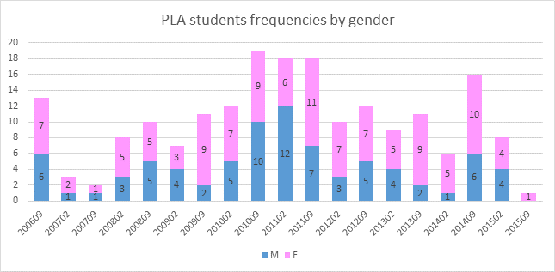
Notes:
Because we are looking at students since the start of BA programming in 2006, this results in distribution over 19 cohorts (Fall 2006 up to Fall 2015).
Although this plot shows the breakdown by sex, it also shows that we are dealing with very few PLA students per cohort, therefore, we are limited in terms of statistical analyses and inferences, particularly in terms of comparing to their cohort-mates only.
We address the cohort-based question in following slides.
What is interesting in the plot is that for cohorts from fall 2010 to spring 2011 there are more male PLA students than females, which is uncommon for our general population which is female skewed, at 60-70%.

Slide 4
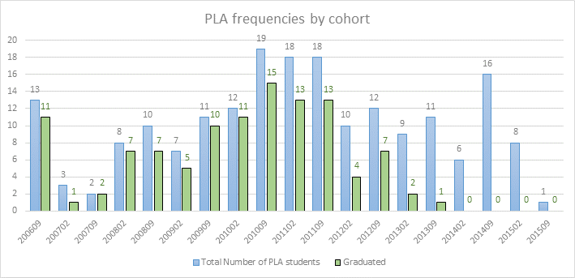
Notes:
Plot shows that students become more persistent. About 70% of PLA students that entered the program have successfully graduated. As you can see in the plot, students who started in the past few years, are less likely to have graduated. This is expected as our students enroll majority part-time, and time-to-degree reflects this.
If one were to narrowly just glance at the within group graduation rate, the PLA students do appear to graduate at significantly higher rates, well over 60% for most older cohorts, when the graduation rates broadly have maxed in the 40s – but of course, this is just the superficial conclusion.

Slide 5
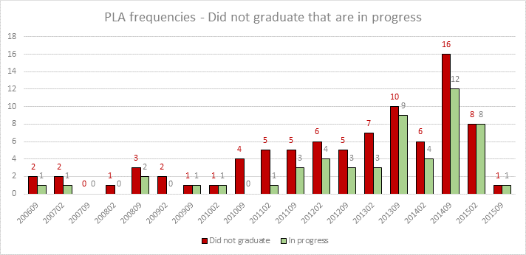
Notes:
Based on our analysis, the majority of the Not Graduated students are in progress and haven’t dropped the program – even in some of those much older cohorts.
These are the types of characteristics that have us questioning the student-based variables, such as incoming academic standing and factors such as motivation or professional experience.

Slide 6
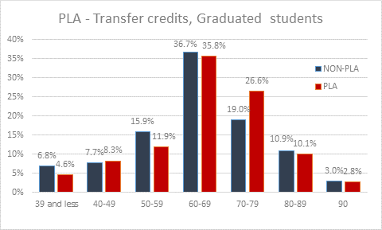
Notes:
As I emphasize about our students, they are a transfer population. And they are coming in with credits ranging from 24-90 applied to their program of choice (we also know that some of these student are coming to us with degrees, but this knowledge is limited)
Inspired by the methodology that the Office of Policy Research used in analyzing Transfer students at CUNY – we decided to look at student success measurement from a Transfer credits as the start line rather than the given cohort date.
This is how we analyzed the data by the number of credits –is the breakdown by number of transfer credits. The majority of students is coming with 60-69 credits, and the distributions for PLA and non-PLA students are the same.
One of the things that we struggled with is making the transfer credits groupings meaningful in terms of setting the cuts, but also something that reflects this part-time trend once they are matriculated.

Slide 7
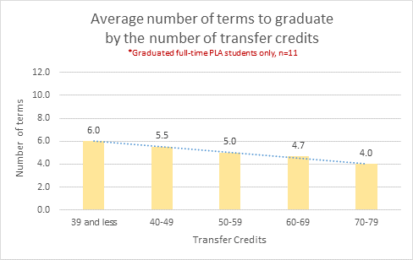
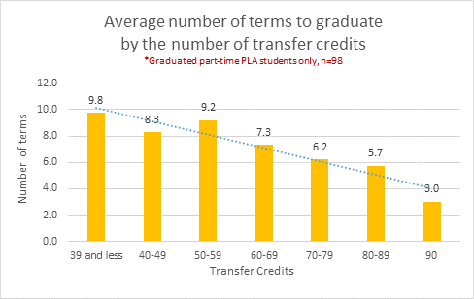
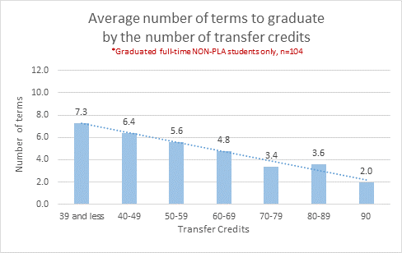
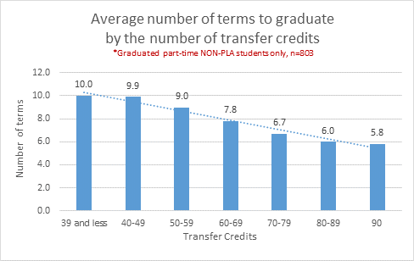
Notes:
So far the main thing we have looked at is the time to degree (by count of terms) by entering transfer credits
Looking at the plots horizontally you, the upper row is PLA, and the bottom row in non-PLA.
For both PLA and NON-PLA there is an effect of number of transfer credits: the more credits the students come with, the faster they graduate (this is why there are trend lines with the negative slope for all 4 plots).
This is one of those intuitive conclusions, but still worth noting – specially as we look to move forward with the analysis.
We can also compare these plots vertically: the left column is full-time students’ data, the right column is part-time students’ data, comparing between PLA and NON-PLA.
This is one of the issues we come against time and again. Only a very small proportion of our students enroll full-time all the time. Generally students fluctuate in status.
For this purpose we operationalized “Full-Time” as enrolling 75% of the time as full-time.
Note that the number of full-time students is several times smaller than part-time students, therefore, we need to be cautious when we are making inferences, because there is a chance of random variability for part-time students.
There is an effect of PT versus FT for both PLA and non-PLA students: it takes more terms for part-time students to graduate – again, intuitive, but important given our population, completers who are likely working full-time as well.
Finally, we can compare these plots across PLA and NON-PLA groups within full-time and part-time separately (by columns). Because the scale of all these plots is the same (0 to 12), we can compare these plots non-statistically (eyeballing).
Left column, again, superficially, it takes less time on average to graduate for full-time PLA versus full-time non-PLA – BUT the sample size for PLA group is extremely small.
To make valid inferences, we need to employ more advanced methods (propensity scores analysis with matching by background covariates). Here we can only talk about general trend.
Right column, at first glance, we see it takes more time on average for NON-PLA students to graduate compared to PLA students.
In our discussion we want to ask about aiming for a more rigorous conclusion, beyond the superficial ones given the data

Slide 8
Questions & Discussion
Missing data problems
When to invest in data entry
vs
When to just wait it out
How else might you approach Prior Learning Credits?
What more should we pay attention to for this population?
Who’s analyzing CLEP (or the like)?
The CUNYFirst question
Propensity score matching – have you PSM’d?
Notes:
Given the size of the population, we are inclined to conduct Propensity Score Matching, to see if these students are indeed different than their peers – but we have some very serious data limitations.
Because we conduct a lot of direct admissions, pre-CUNYFirst, the majority of applicant data was not getting into the UAPC system, which made our ASTA files overwhelmingly deficient – anything we wanted to know about our incoming students we would have to find in paper files – and we have for one project gone to these files and conducted data entry.
But now we are looking at up to 19 cohorts, and a total population of thousands(?) with missing records, regarding their incoming GPA, number of schools attended, credits attempted prior, etc.
are we missing something we don’t know
if we were to go paper route the GPA calculation would not be same as UAPC (right?)
Our IT folks knew where to find the data in SIMS, but do not know about CUNYFirst, and there seem to be instances where the conversion places past credits in one area, but are not currently entered into the same (?) – there is a good chance that the data is incomplete as we have it, because we do not know how to get at the more recent exam-based credits

