Slide 1
IR as a Graphic Novel
BMCC’s Upshot Newsletter

Slide 2
How do we get the table to tell a story?
New Freshmen in Fall 2014 | Grade | Count | % Attempting College Math | Number Attempting College Math | % of Attempted who pass | % of total cohort passing college math | Number Passing College Math
MAT 12 | S | 527 | 53.9% | 284 | 72.5% | 15.8% | 206
 | R | 614 | 1.6% | 10 | 100.0% | 0.5% | 7
 | W WN WD | 86 | 0.0% | 0 | 63.6% | 0.0% | 0
 | WU | 74 | 1.4% | 1 |  | 0.0% | 0
 | SUM | 1301 | 22.7% | 295 | 72.2% | 16% | 213
MAT 51 | S | 398 | 49.0% | 195 | 73.8% | 19.3% | 144
 | R | 248 | 4.0% | 10 | 100.0% | 1.2% | 9
 | W WN WD | 43 | 2.3% | 1 | 0.0% | 0.1% | 1
 | WU | 59 | 1.7% | 1 | 90.9% | 0.1% | 1
 | SUM | 748 | 27.7% | 207 | 74.9% | 20.7% | 155

Slide 3
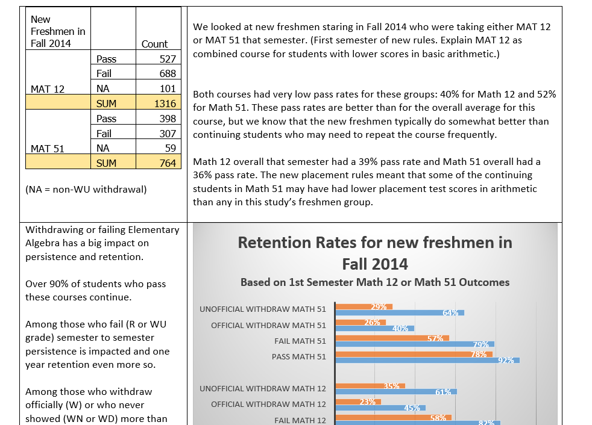
We created a “story board” to talk about the project with the Provost and others.

Slide 4
Round % to whole #
Take 1
Taking WU out of the “Fail” Group to understand retention
Take 2

Slide 7
These thermometer charts are easy!
We started with a Microsoft Newsletter Template and worked with Public Affairs to get the right logo and positioning for the overall document.

