Slide 1
Two-semester Goal-setting Project
Jenny Zhu
Institutional Research & Assessment
LaGuardia Community College
January 29, 2016

Slide 2
Two-semester Goal-setting Project
Stepwise Logistic Regression—A method of combining information on a student to calculate a probability of return.
Goal: Predict the return (or graduation) of Fall 2014 degree students, based on:
  Fall 2012 to Fall 2013 actual
  Spring 2013 to Spring 2014 actual
  Fall 2013 to Fall 2014 actual

Slide 4
Results of fall 2014 predictions
15,935 Fall 2014 Degree Students
  Predicted probability of return/graduation: 61.6%
  Actual return/graduation rate: 64.3%
  100 students with highest probability of return: 85% returned
  100 students with lowest probability of return: 28% returned

Slide 5
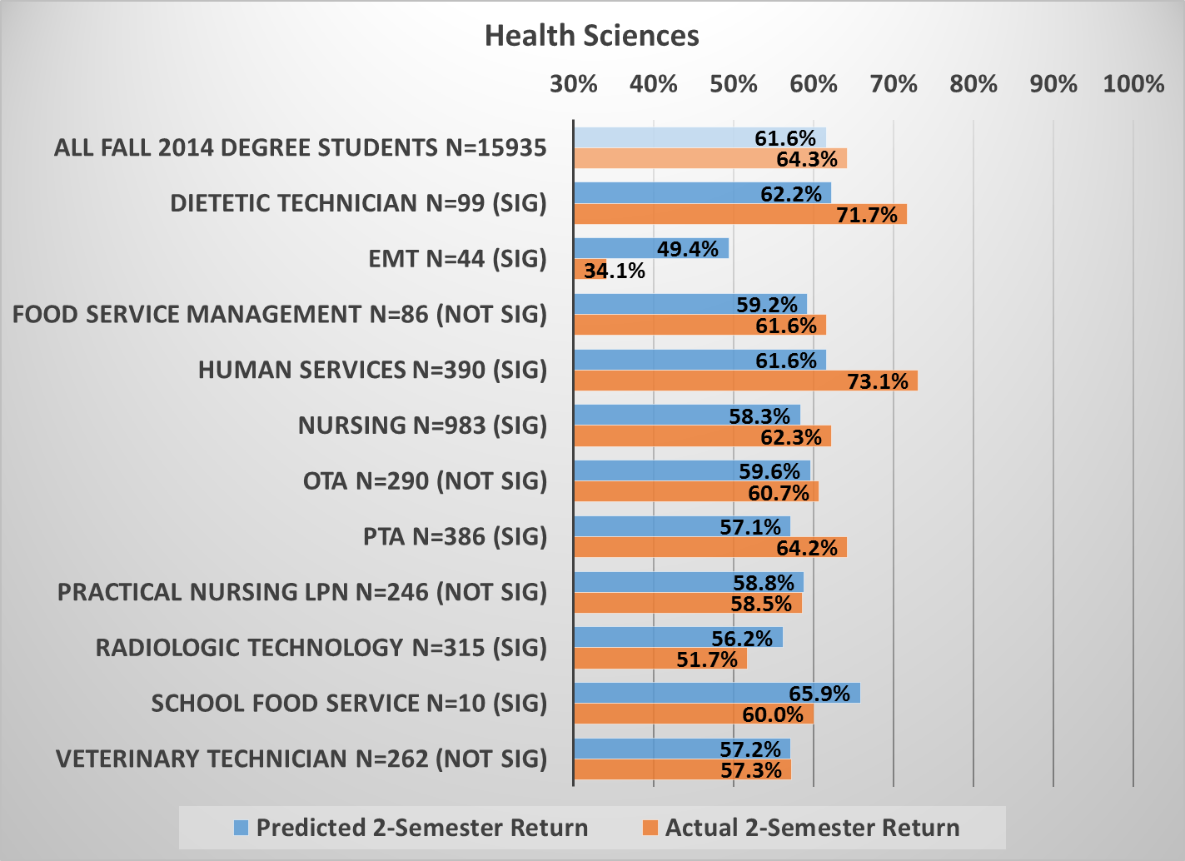

Slide 6
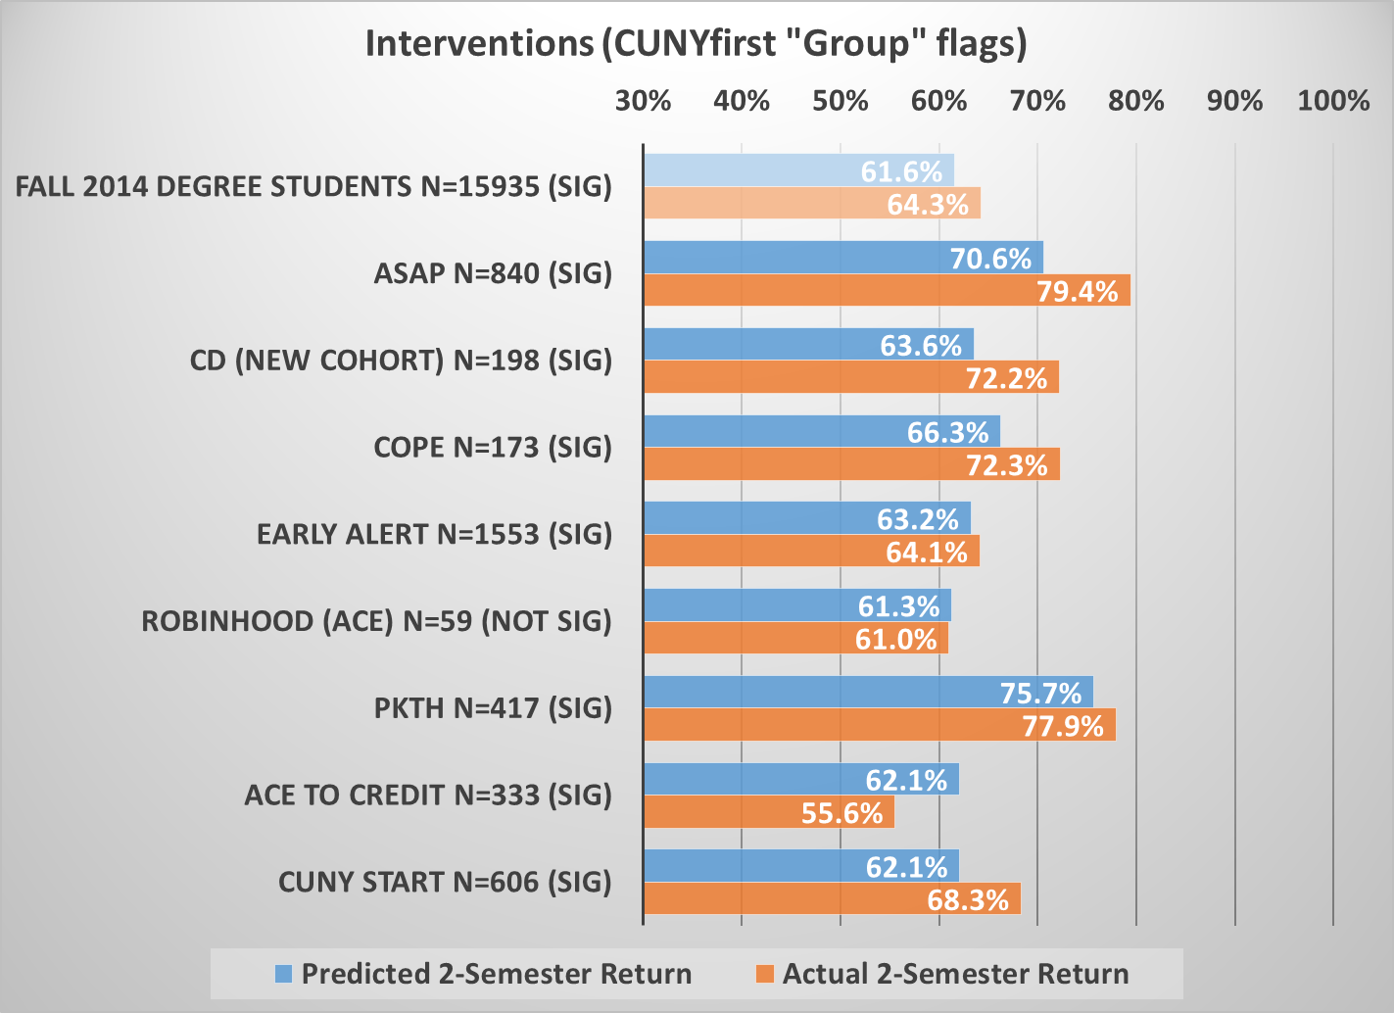

Slide 8
How about looking at SEMS data?
Ask…
  Does visiting an office improve retention above expectations?
  Does visiting an office more often improve retention above expectations?
  Are some offices better ones to visit?

Slide 9
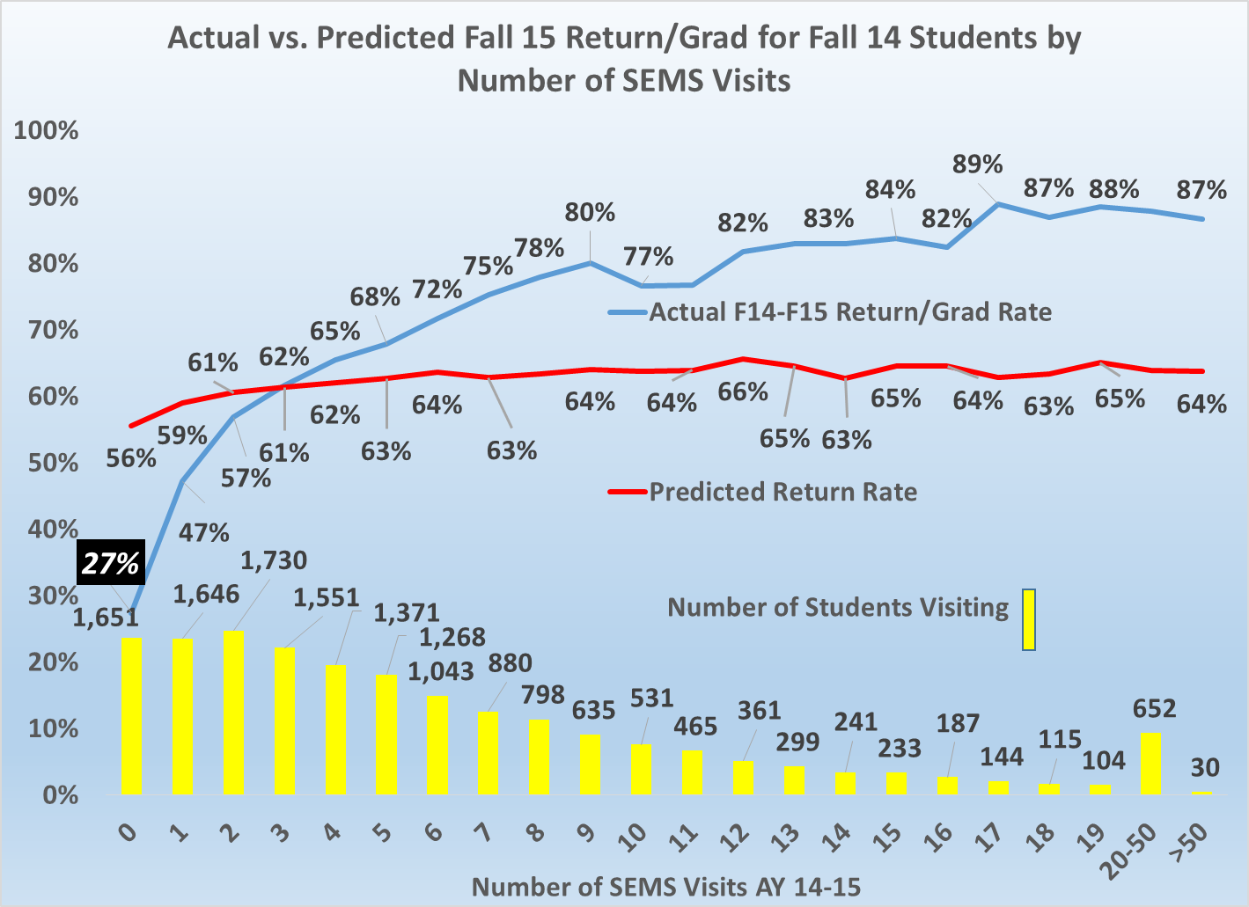
Not visiting any office is very, very bad!

Slide 10
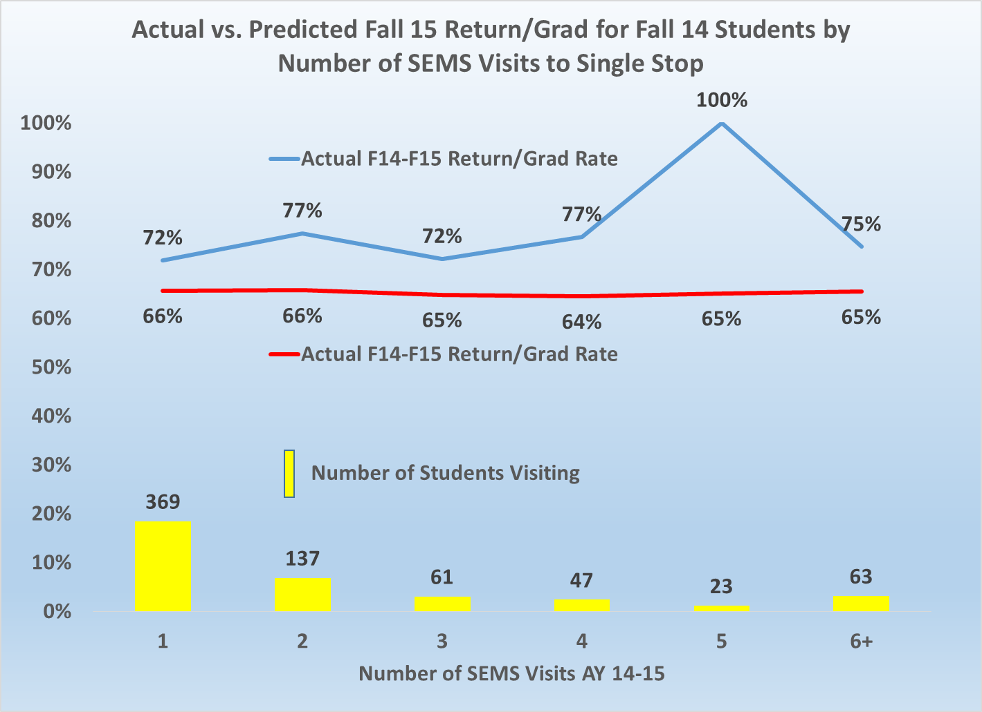
Visiting Single Stop is beneficial!

Slide 11
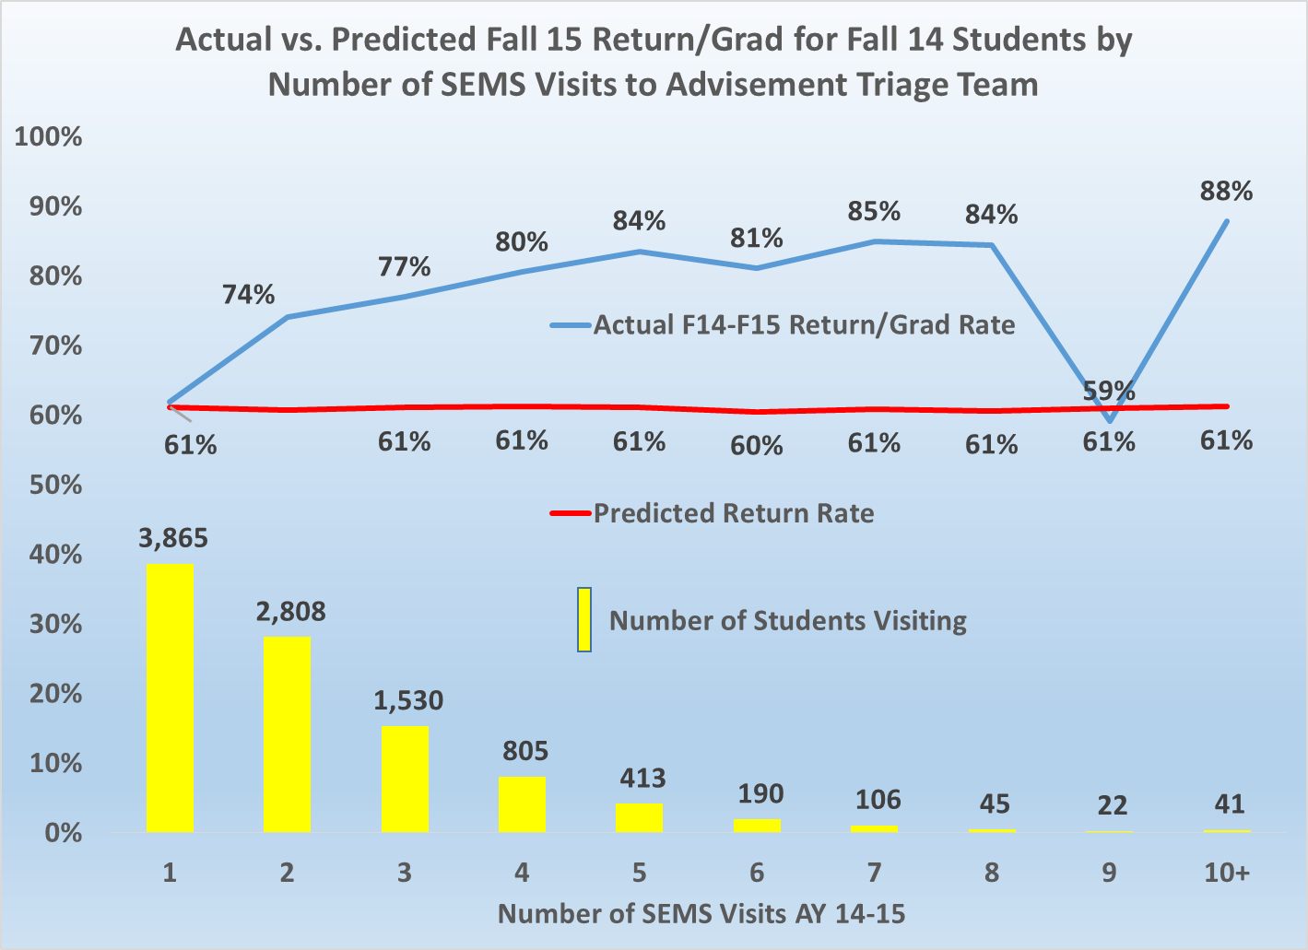
Seeing an advisor once is the norm.
More than once helps (except not 9 times).

Slide 12
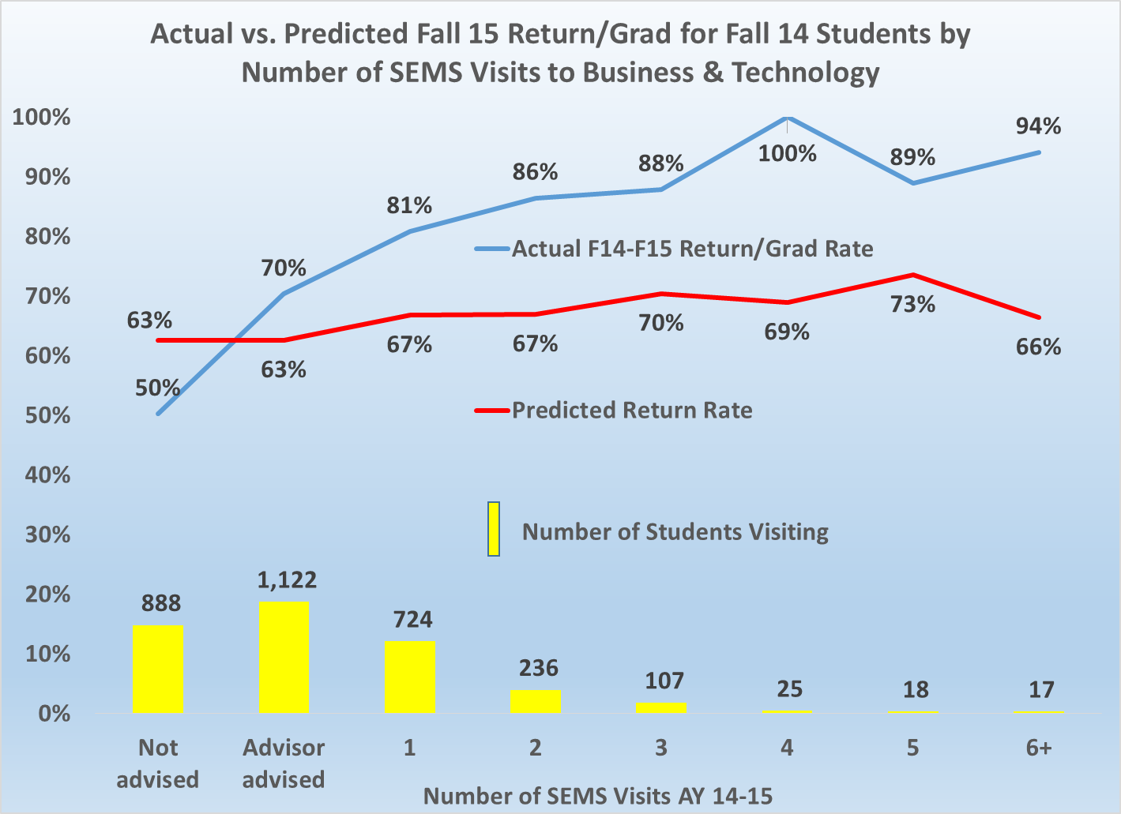
Seeing an advisor is good;
Seeing a faculty member is better!

Slide 13
The future: IR&A Strategic Directions
“Distributed research”
  Get more areas involved in setting their own research agenda and provide support
    Get data to them that prompts hypotheses
    Help them design good action-oriented research
    Provide data to test the hypothesis
    Assist in documenting “closing the loop” assessment
“Counter-example” research
  Why do some students do the opposite of prediction?

Slide 14
Distributed research, current examples:
Health sciences, Phil Gimber/Jill Janofsky
  Prompting data: health sciences student retention
  Hypothesis: we know early which students have no chance of reaching candidacy
  Analytic data: probability of successful candidacy of:
    Those who are placed into Math 096
    Those who have below a 2.00 in first semester, etc.
  Action: Change early advising, present data, be more forceful, develop “Plan B” majors

Slide 15
Distributed research, current examples:
Transfer services-Bart Grachan
Prompting data: survey results showing dissatisfaction with Transfer services
Hypothesis: some CUNY colleges and majors accept the few transfer credits?
Analytic data: look at number of credits needed to graduate with a CUNY BA by our grads:
  http://laguardia.edu/WorkArea/linkit.aspx?LinkIdentifier=id&ItemID=21474871622&libID=21474872019
  Action: focus on specific problem areas

Slide 16
Counter-example research…
Did Not Return
Returned
Predicted Return
Why were the odds wrong? Who are these students?
Successful as predicted
Why did these students beat the odds? Who are these students?
Predicted Non-return
Unsuccessful as predicted

